Slide 1

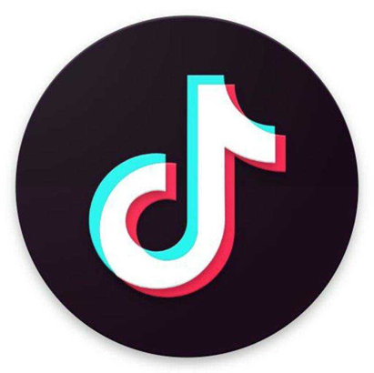
抖音
Research on TIKTOK
Research on TIKTOK
Research on TIKTOK
Recommended algorithm and profit strategy of TIKTOK
Xu Shibo 19446616
Lu Xinyi 19543833
Lei Jiani 19433050
Su Yueqi 19439377

Slide 2




Recommended algorithm and profit strategy of TIKTOK
Background
Recommendation algorithm and strategy
User profit strategy
Platform
profit strategy
2

Slide 3
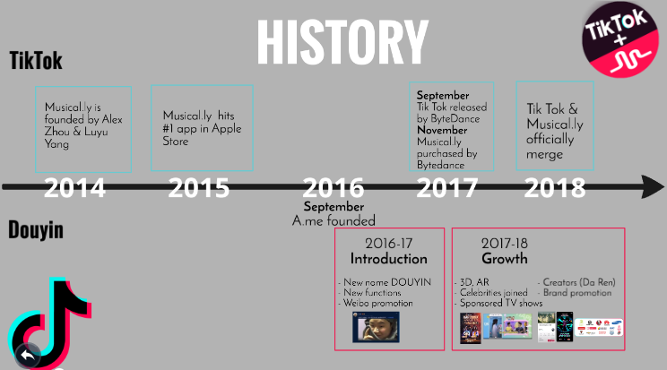
Background
Timeline
3

Slide 4
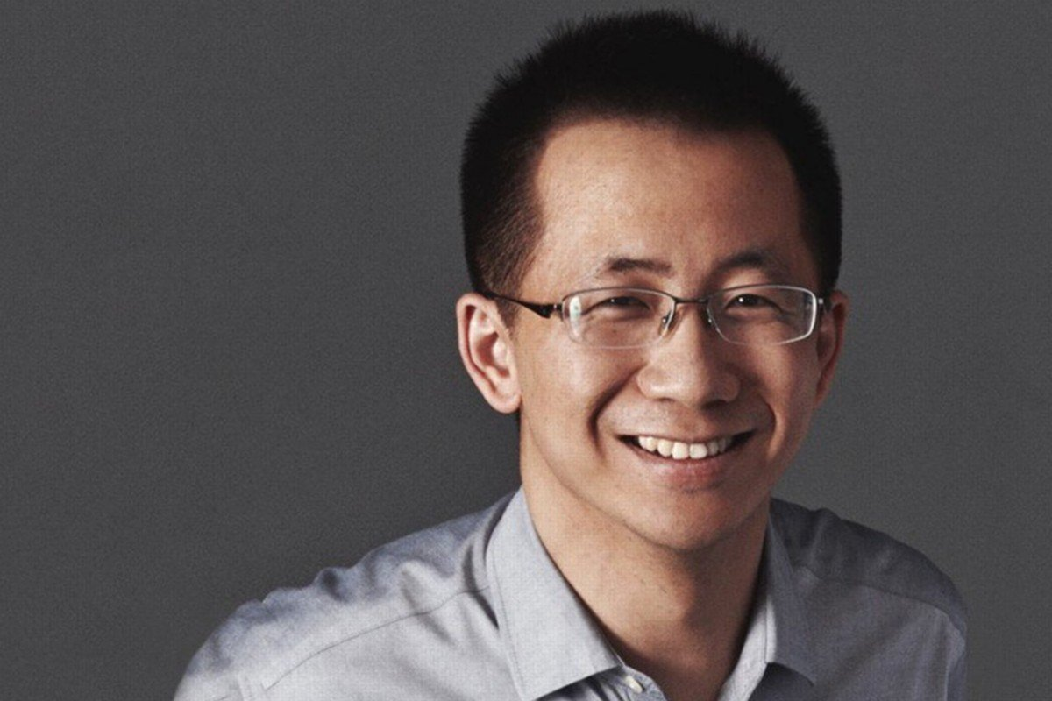
ByteDance' History
· Founded in 2012 by Yiming Zhang,now CEO of Byte Dance
· Best known for mobile apps with entertainment value
· Vision: Build global creation and interaction platforms.

4

Slide 5
Products and Services
· ByteDance's products continue to grow in the global market. Current its apps are available in over 40 countries including China, Japan, South Korea, etc
· ByteDance has many popular apps including Tiktok, Douyin (the Chinese version of Tiktok), Huoshan, Toutiao, TopBuzz, News Republic, iXigua, Pearvideo, etc)

5

Slide 6
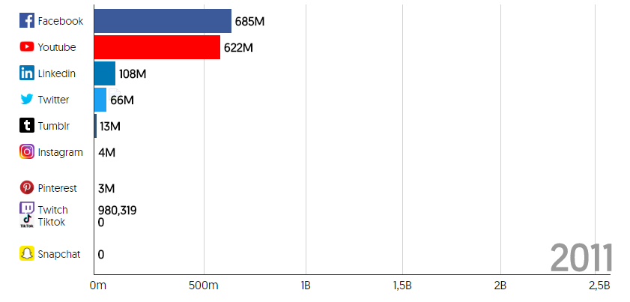
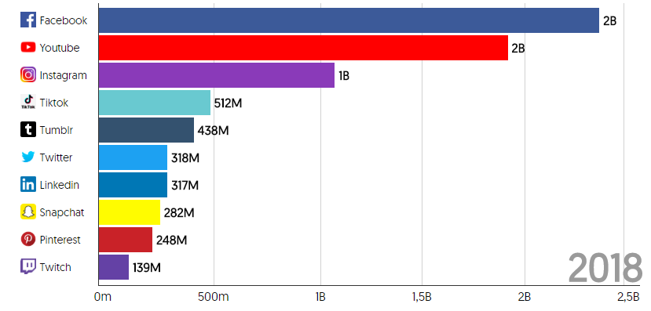
The explosive growth of Tiktok

Source:Influencer Marketing Hub
6

Slide 7
Tiktok's Innovation

· Incorporate Brainwashing and popular music as the BGM in order to increase the click rate
· Supported by large-scale machine learning and deep learning algorithms to learn about user's preferences
7

Slide 8

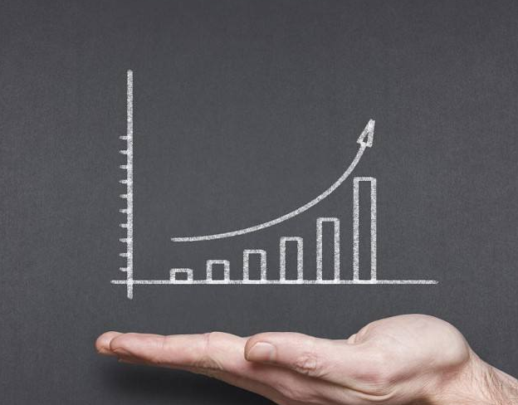
TikTok’s recommendation algorithm and strategy
Algorithm
Strategy
8

Slide 9
TikTok’s recommendation model
Solve the problem of less recommendation content
Recommended algorithm model
Collaborative filtering model
Deep learning model
Supervised learning model
Analyze complex music and video data
Realize tag classification
9

Slide 10
Recommended strategy
Feature recommendat-ion strategy
Flow pools and superposition strategy
Time control and video library mining
11

Slide 11

Feature recommendation strategy
Age
Gender
Location
Using frequency
Using time
Hobby
11

Slide 12
Flow pools and superposition strategy
Let's assume that you are now a short video author:
You just released a short video, then the TikTok will push your video to 1000 user.
After 1000 user saw video, your video will have a score. If your score reached a threshold, it will continue push this video to 10000 user.
If your score still reached the threshold value, then TikTok will push this video to 1 million people, if you still can reach the threshold it will continue to expand the scale.
10,000
1,000
100,000
…………
…………
…………
12

Slide 13

Flow pools and superposition strategy
Amount of comment
Rate of completion
Amount of Quantity
Amount of forwarding
The amount of forwarding has the highest weight, because forward for users requires the biggest amount of operation, forwarding means that the user is very like this video.
The smallest weight is thumb up, because in Tiktok, thumb up can be done with just a few taps on the screen.
13

Slide 14


Time control and video library mining
Tiktok is a platform that emphasizes timeliness.
Tiktok hopes that its video can keep updating quickly all the time. It does not want users to see video that has been popular for a long time.
However Tiktok also can give some chance to the old but not popular video.
14

Slide 15
Why can we make profits on TikTok
DAU(Daily Active User)
320 million people
Daily TikTok usage time
25-30 minutes
Advertisement density
1 ad/5min
Daily advertisement views
5 times
16

Slide 16
Advertising price on TikTok
Principle
Based on the number of followers
10000 followers=¥300/ad
Price
3-5 cents per follower
17

Slide 17
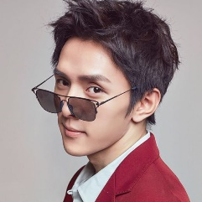
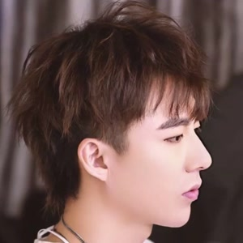
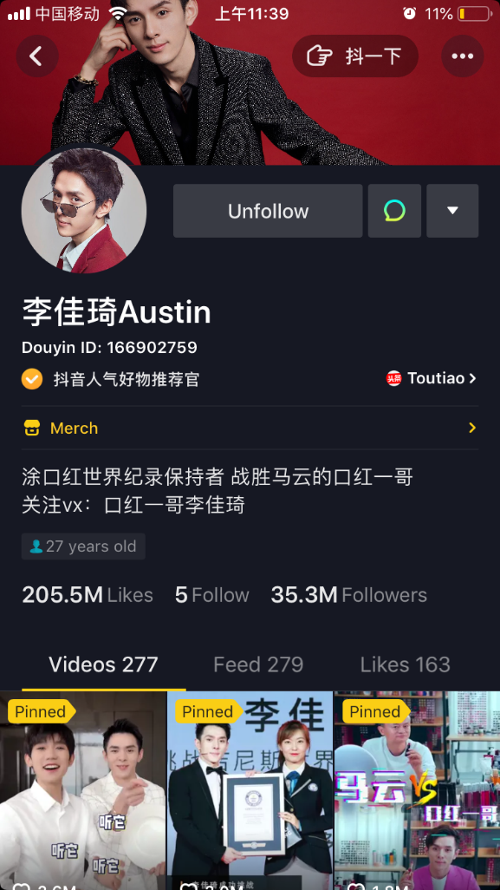
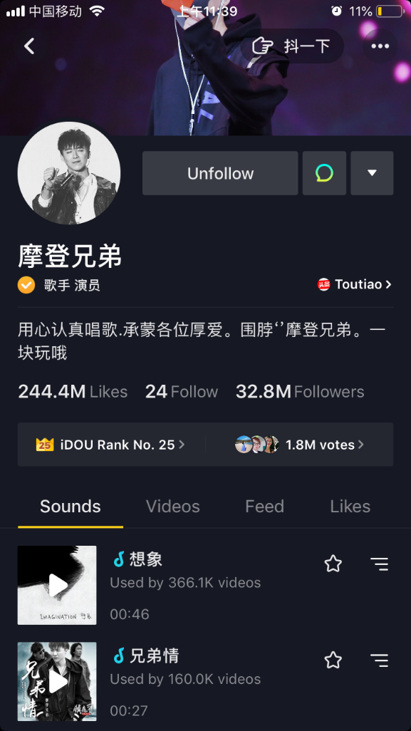
Head celebrities in TikTok (1 million/ad)
Li Jiaqi
Liu Yuning
18

Slide 18
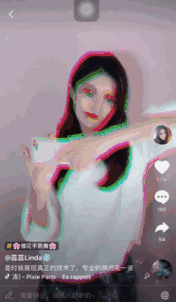
Advertising methods on TikTok
Star Map
Brand-customized advertising
video stickers
name broadcasting
image endorsement
interactive stickers
the official advertising platform
advantages in distribution
advantages in payment
19

Slide 19
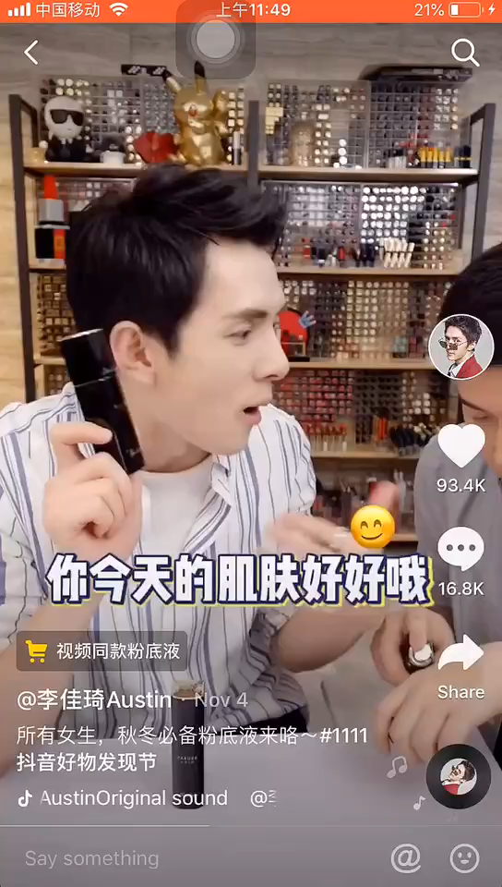
Accesses to the advertising products
Merch
Taobao and Pinduoduo links
have commissions
Qualifications：
posted ten videos
name verification
more than 1,000 followers
19

Slide 20
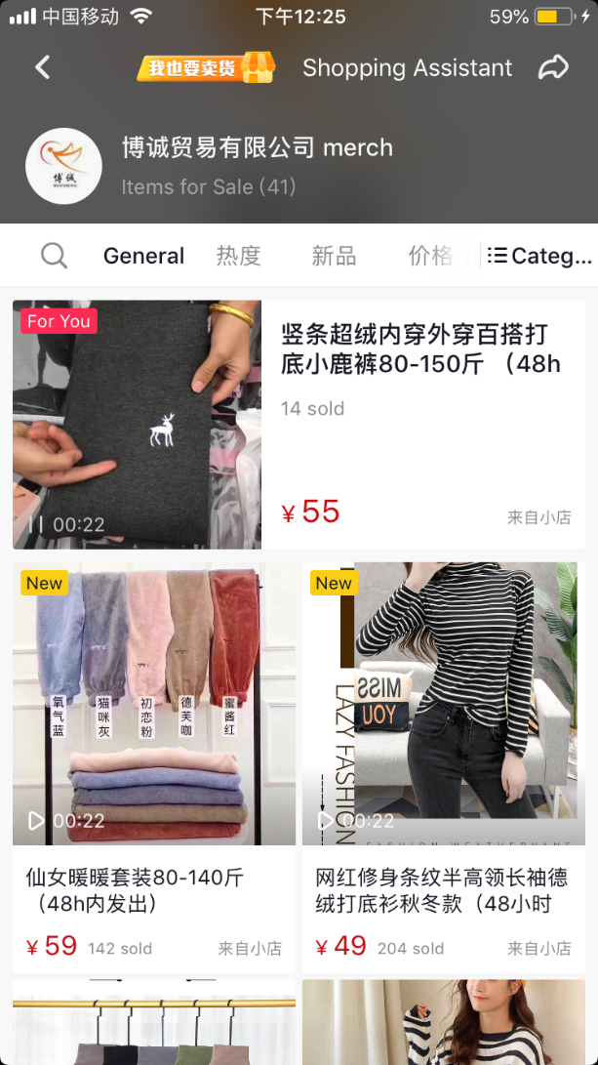
Accesses to the advertising products
TikTok small shop
have a number of followers
have source of goods
TikTok takes 10% commission
20

Slide 21
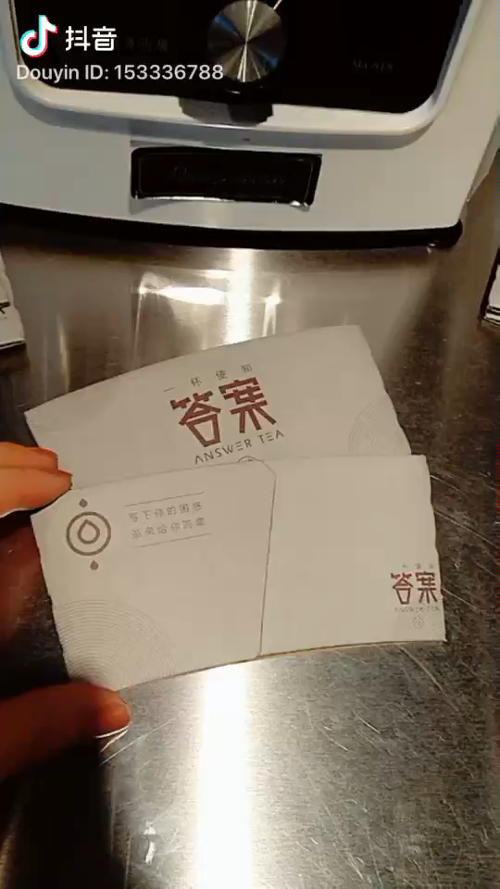
Companies on TikTok
Intention & Success
· Increasing sales of a product
Haidilao Hot Pot
peppa pig
· Improving brand awareness
Answer Tea
Failure
· Lack investment
· Cooperating with celebrities is better
21

Slide 22
Restrictions & improvements of advertising on TikTok
01
02
03
Shield some brand logos and QR Code
Lack of sticky followers
Improvement:
Channeling followers to other platforms, such as Wechat shops and Weibo
Shopping desire cannot be fully stimulated
Improvement:
· Innovation
· High quality content
TikTok is not only a platform for sharing your life, it can also bring you profits.
22

Slide 23
Tiktok platform
profit strategy

Slide 24
Paid promotion strategy
Advertising strategy
Dou+ function
The delivery time is 6 hours, 12 hours and 24 hours, the amount of delivery can also be selected by yourself. the estimated playback volume will be different
Cover type ad video
Open-screen advertising, static or dynamic on the screen for 5 seconds

System intelligent delivery
Based on the title and content of the video to the users with corresponding hobbies

Plug-in ad video
Information flow advertisement
Cooperate with short video experts
Custom targeted delivery
Specify gender, age range, area, and interest tags
Related fans delivery
This strategy could delivery videos to the fan or to a group similar to such a fan
24

Slide 25

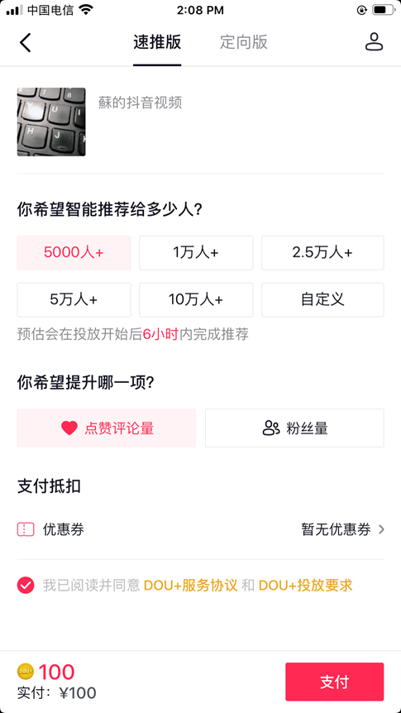
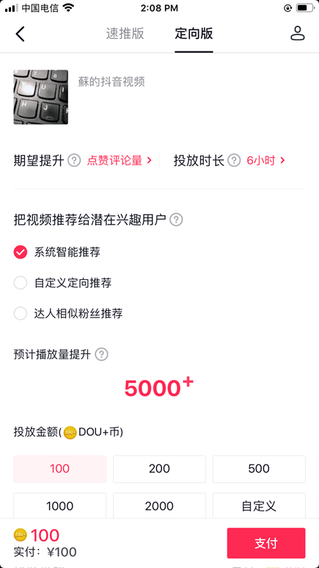
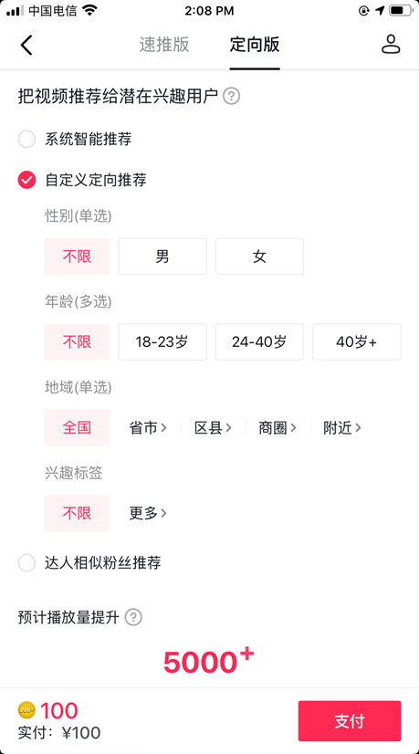
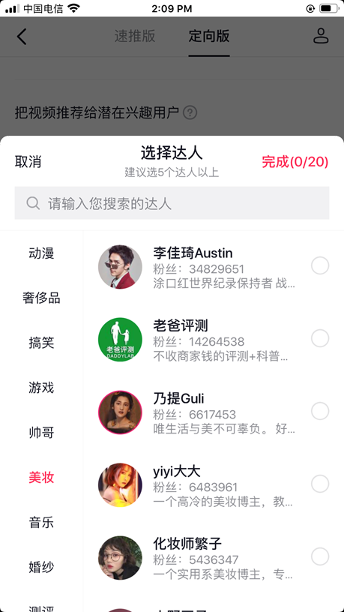
Paid promotion strategy
Dou+ function
System intelligent
Custom targeted
Related fans
25

Slide 26

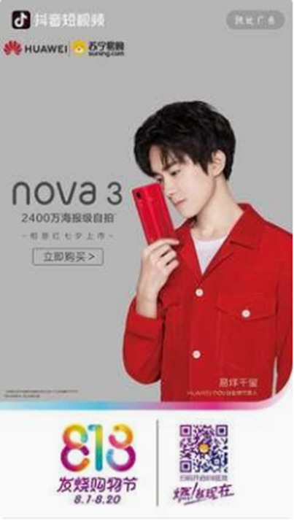
Advertising strategy
Cover type ad video
Plug-in ad video
Open ad, that occupies the entire page of the phone when the app is opened, and will remain static or dynamic on the screen for 5 seconds
Information flow advertising, where advertisers combine advertising and short video content 【1】
Cooperate with short video experts to carry out advertising
26

Slide 27
Conclusion
Tiktok, the social media video app grows quickly and gains popularity these years. Recommended algorithm model, realize tag classification, analyze massive music and video data; feature recommendation strategy, take particular age, gender, geographical location and popular trend into consideration; flow pools and superposition strategy expand high-quality videos to large scales; time control and video library mining also enable tiktok spread widely and fresh quickly.
These algorithm models help platform make various decisions on strategies, becoming a celebrity on tiktok is a good way to bring profits to both individuals and corporates. Different corporations with celebrities and e-commerce, different methods of advertising all contribute to tiktok’s economic growth.
28

Slide 28
Reference
Influencer Market Hub (2019). 37 TikTok Statistics That Will Blow Retrieved from https://influencermarketinghub.com/tiktok-statistics/
Rihui,H. (2019). Application types and profit models of short video. China Academic Journal Electronic Publishing House.
Li Mohan. Limitation and countermeasure analysis of recommendation mechanism of TikTok algorithm [J]. New media research, 2019, 5(02):32-33.
Screenshot of Li Jiaqi’s homepage in TikTok APP.
Screenshot of Liu Yuning’s homepage in TikTok APP.
Screenshot of Su’s usingpage in TikTok APP.
29

Slide 29
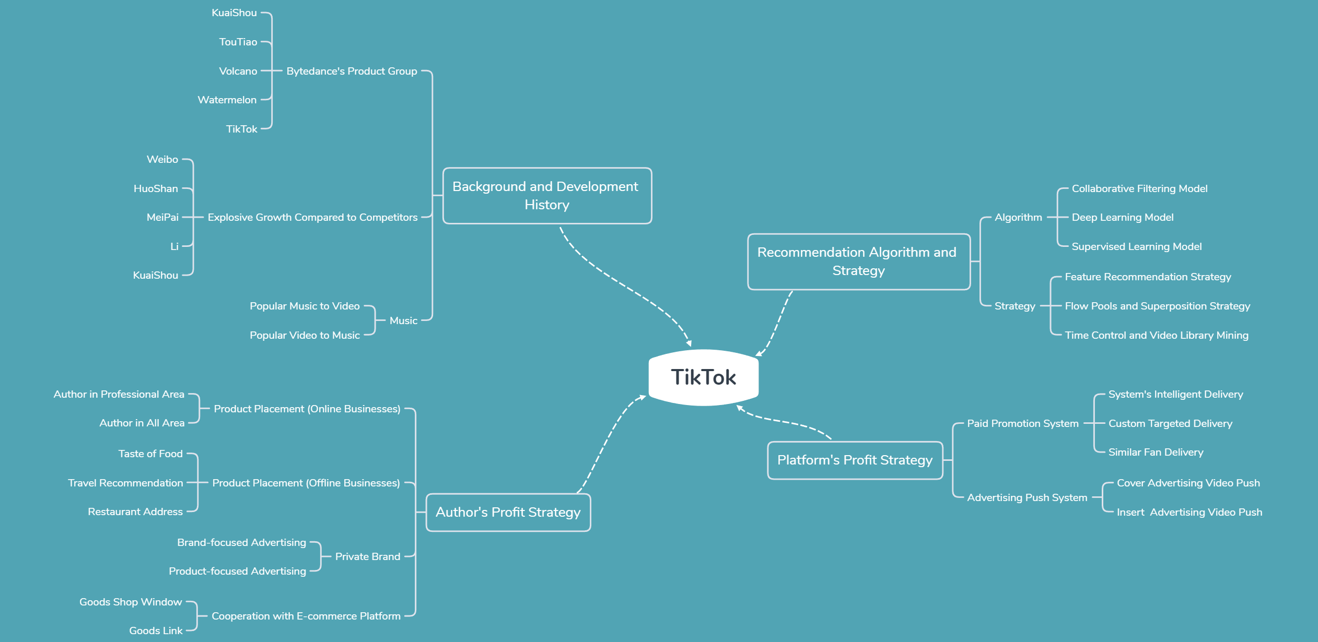
Mind Map of TikTok from Group Discussion
29

Slide 30
THANK YOU!
THANK YOU!
THANK YOU!
BY GROUP2
Nov.28

